Slide 1
CSE 522 & 410J Lecture 20 November 10, 2020

Slide 2
Object-Oriented Concepts
Java Memory Management
JUnit Testing
Contracts & Aspects
Java Reflection
OO Requirements
Use-Case Driven Design
Unified Modeling Language
Towards Web Services
SOAP and ReST
Spring Tool Suite

Slide 3
Design by Contract and Inheritance
Inheritance enables subclasses to redeclare methods of the parent class, as well as provide an implementation for abstract methods of the parent class.
Polymorphism and dynamic binding combined with inheritance are powerful programming tools provided by object oriented languages.
How can the Design-by-Contract can be extended to handle these concepts?
Notes:
Cornerstone
Powerful but with the correct chekcs a number of things can go wrong

Slide 4
Inheritance Policy
When a sub-class method over-rides a super-class method the sub-class pre-condition is automatically combined with the super-class pre-condition using disjunction (||).
When a sub-class method over-rides a super-class method the sub-class post-condition is automatically combined with the super-class post-condition using conjunction (&&).
Also, the invariants of the super-class are inherited by the sub-classes; invariants are automatically combined by conjunction (&&).

Slide 5
Clarification
When a sub-class method omits a pre-condition or a post-condition, automatically the condition is taken from a super-class method if one is explicitly given.
In the absence of any explicitly stated condition, the default condition for pre-conditions and post-conditions is true.

Slide 6
Example: Overdraft Account
//@invariant balance >= 0
class Account {
// … assume constructor defined …
//@requires x > 0
void withdraw(int x) { balance = balance – x; }
int balance;
}
The declared
//@invariant
for OD_Account
does not enforce
balance >= -1000.
Reason:
balance >= 0
&&
balance >= -1000
≡
balance >= 0
//@invariant balance >= -1000
class OD_Account extends Account {
// … assume constructor defined …
void withdraw(int x) { balance = balance – x; }
}

Slide 7
Overdraft Account (version 2)
class Account {
// … assume constructor defined …
// @requires x > 0
// @ensures balance >= 0
void withdraw(int x) { balance = balance – x; }
int balance;
}
The condition
balance >= 0
should not be
a class invariant,
since it does not
apply to every
subclass.
class OD_Account extends Account {
// … assume constructor defined …
// @requires x > 0
// @ensures balance >= -1000
void withdraw(int x) { balance = balance – x; }
}
But the && of
post-conditions
is balance >= 0.
Thus the desired
flexibility for
OD_Account is
not obtained.

Slide 8

Liskov Substitution Principle
A property p that is true of a type (or class) T1 should also be true for every subtype (subclass) T2 of T1.
Thus, if balance ≥ 0 is true of Account
it must also be true of every subclass
of Account. Since we want the property
balance ≥ -1000 for OD_Account, we
should not make it a subclass of Account.
Barbara Liskov

Slide 9
Discussion
We would like OD_Account to be a subclass of Account.
Therefore we should not write two class invariants, and we should not write two post-conditions for withdraw.
Can we re-formulate the solution with just one class invariant?
See next slide …

Slide 10
//@invariant balance >= minimum
class Account {
public Account(int b, int m) {
balance = b; minimum = m;
}
//@requires x > 0)
int withdraw(int x) {
balance = balance - x;
return balance;
}
protected int balance, minimum;
}
class OD_Account {
public OD_Account(int b) {
acc = new Account(b, -1000);
}
int withdraw(int x) {
return acc.withdraw(x);
}
private Account acc;
}
Better
Solution
We avoid the
subclass relation
altogether.
We use delegation
instead of
inheritance.
Class Account
enforces whatever
minimum balance
is desired.

Slide 11
Contracts vs JUnit Tests
Contracts are useful when software correctness is critical, as in safety-critical systems, where cost of failure is very high – loss of life, rocket explosion, etc.
Contracts complement JUnit tests. Contracts are internal to the code, JUnit tests are external to the code.
Contracts can pinpoint cause of failure better better than JUnit tests. JUnit tests provide clean separation of Java program from testing code.
Writing tests and contracts requires practice, and sometimes seemingly correct contracts may be trivially satisfied – recall sort contract in Lecture 19 slide #12.

Slide 12
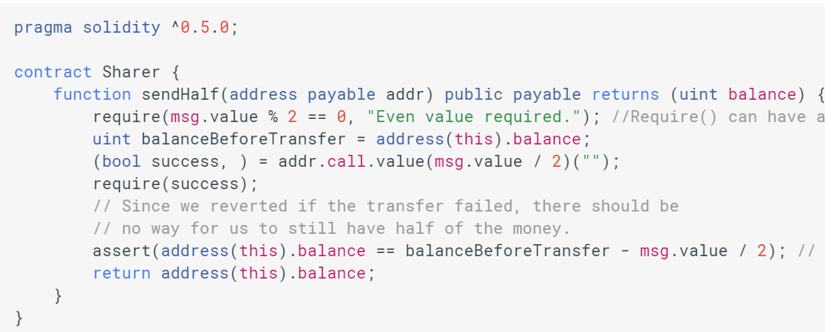
Smart Contracts in Blockchain
The term Smart Contract used in the Blockchain literature
has more complex semantics, but also makes use of
pre- and post-conditions, and invariants.
requires
ensures

Slide 13
A4 Part 2 – Writing Contracts
Guidance on writing the required contracts for AbsTree, Tree, and DupTree.
* class Tree – no changes needed.
* AbsTree.insert(n) – no changes needed
* AbsTree.delete(n) – write pre-condition stating that we can’t delete the last value in the tree.
* DupTree.insert(n) is recursive but DupTree.delete(n) is not. Hence, for delete(n), there is a need to introduce local variables n_count and old_n_count to facilitate contract checking.

Slide 14
A4 Part 2 –Contracts (cont’d)
* The post-condition of DupTree.insert(n) can be written using the fields count, old_count, and value. There are two cases: value == n, and value != n.
* The post-condition of DupTree.delete(n) can be written using n_count, old_n_count, and the member() test. There are three cases: old_n_count == 0, old_n_count == 1, and old_n_count > 1.
* Finally, the contracts for AbsTree_Iterator are described in the assignment itself.

Slide 15
Aspect-Oriented Programming (AOP)
An aspect is a cross-cutting concern of an application.
For example, logging, tracing, profiling, etc., are not the main concern of an application.
Another example is contract checking.
Intertwining the cross-cutting concern with the main logic of the application goes against separation of concerns.
Spring Tool Suite also uses AOP in its implementation.

Slide 16
AspectJ History
AspectJ is an AOP extension of Java created in 1998 at Xerox PARC.
Available in Eclipse open-source projects, both stand-alone and integrated into Eclipse.
AspectJ has become a widely used de facto standard for AOP.
It uses Java-like syntax, and included IDE integrations for displaying crosscutting structure.

Slide 17
Let’s see an example for a quick overview of the overall approach and then we will examine the features of AspectJ Link: https://www.eclipse.org/aspectj/doc/released/ progguide/starting.html

Slide 18
Example 1: Simple Logging
Suppose we want to log every entry and exit of all methods in a program.
class Test {
public void one() {
System.out.println("Execute Body of Test.one()");
}
public void two() {
System.out.println("Execute Body of Test.two()");
}
}
The traditional
way of meeting this requirement shown on right, but this approach violates the principle of separation of concerns.
class Test {
public void one() {
System.out.println(“Entering Test.one()");
System.out.println("Execute Body of Test.one()");
System.out.println(“Leaving Test.one()");
}
public void two() {
System.out.println(“Entering Test.two()");
System.out.println("Execute Body of Test.two()");
System.out.println(“Leaving Test.two()");}
}

Slide 19
Aspects: Separation of Concerns
class Test {
public void one() {
System.out.println("Executing Test.one()");
}
public void two() {
System.out.println("Executing Test.two()");
}
}
“All methods
regardless of
result type,
name, and
# arguments”
Java
Program
Requiring
Logging
public aspect LoggingAspect {
pointcut method() : execution(* *(..));
before() : method() {
System.out.println("Entering " +
thisJoinPoint.getSignature().toString());
}
after() : method() {
System.out.println("Leaving " +
thisJoinPoint.getSignature().toString());
}
}
AspectJ
Code
For
Logger
Advice
code
https://en.wikipedia.org/wiki/Aspect_weaver

Slide 20
Overall Methodology
Java
code
AspectJ
aspects
AspectJ
Weaver
Woven code
in Java
Woven code can be compiled by Java compiler and executed.

Slide 21
Pictorially
Advice code
executed at
each Join Point
Join Points
Program Execution

Slide 22
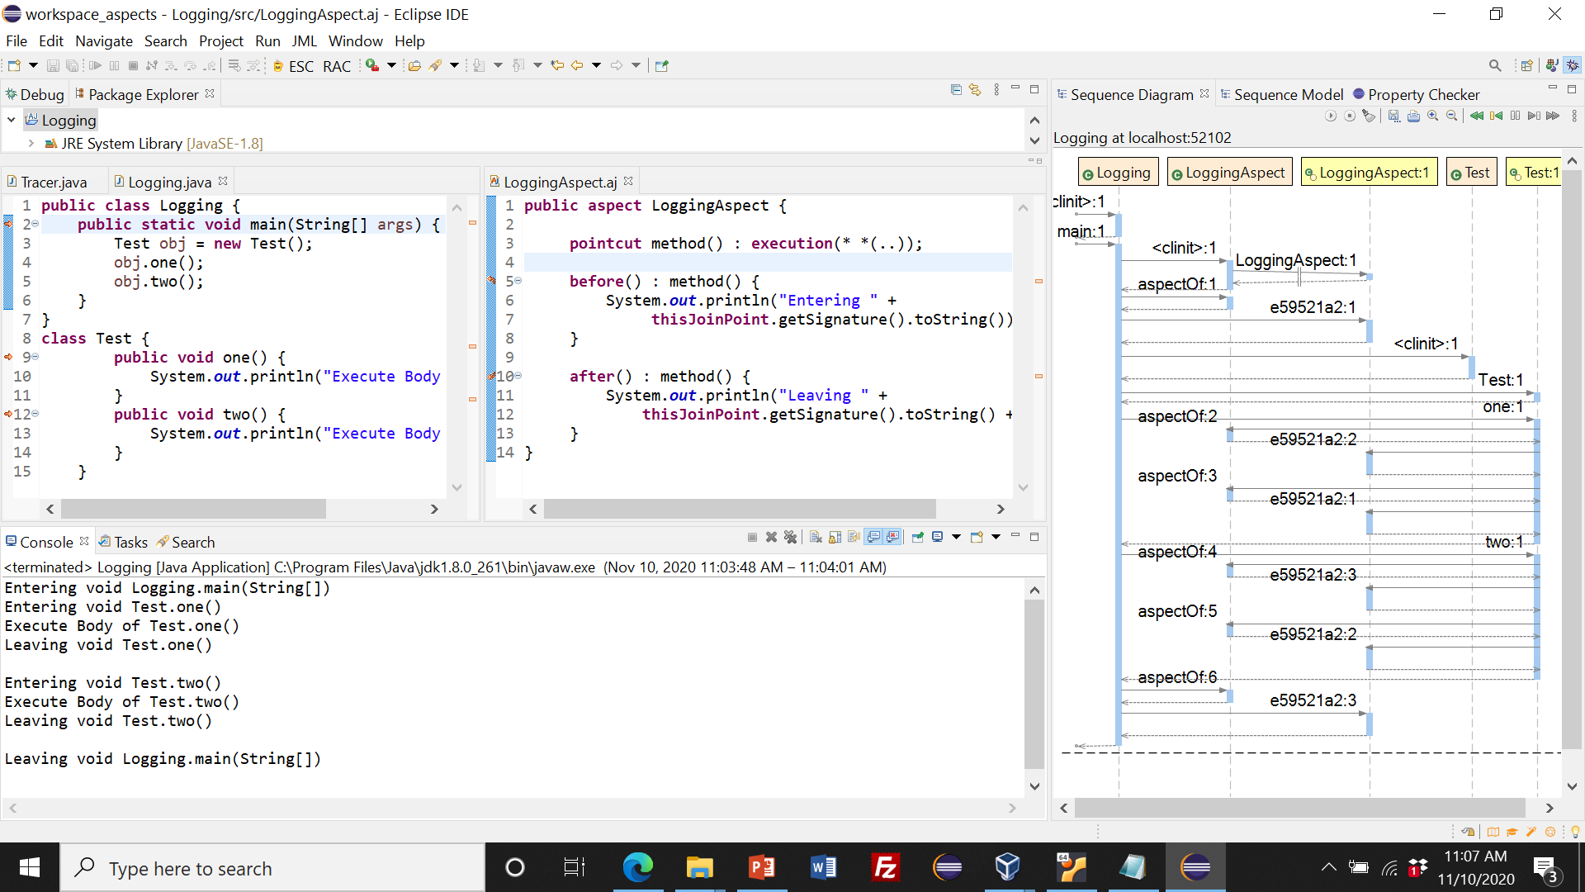
Sample Run Under JIVE
Logger created
as AspectJ project.
`main’
added.
Execution shows
that logging has
taken place.

Slide 23
Installing AspectJ
AspectJ can be installed as an Eclipse Plugin from
http://download.eclipse.org/tools/ajdt/410/dev/update
The demos in this lecture are using the version:
AspectJ Development Tools
version 2.2.4.202007241909

Slide 24
AspectJ Language
An aspect is a unit of modularity for cross-cutting concerns, similar to a class, and consists of point cuts, advice, and inter-type declarations.
The key concept is that of a Join Point which is a well-defined point in program flow.
Programming Constructs:
Point Cut – a set of one or more Join Points.
Advice – action to be taken at a Join Point.
Let’s see an example ...
https://www.eclipse.org/aspectj/doc/released/progguide/starting-aspectj.html

Slide 25
Figure Elements
Figure
FigureElement
1
1..*
makePoint()
makeLine()
setXY(int x, int y)
Point
Line
x,y: int
p1,p2: Point
setX(int x)
setY(int y)
setP1(Point p)
setP2(Point p)

Slide 26
Sample Point Cuts and Advice
pointcut move(): call( void FigureElement.setXY(int,int) ) || call( void Point.setX(int) ) || call( void Point.setY(int) ) || call (void Line.setP1(Point) ) || call( void Line.setP2(Point) );
Advice (code) that runs before the move pointcut:
before(): move() { System.out.println("About to move"); }
Advice (code) that runs after the move pointcut:
after(): move() { System.out.println("Just successfully moved"); }

Slide 27
Types of Point Cuts in AspectJ
When a particular method body executes:
execution(void Point.setX(int))
When a method is called:
call(void Point.setX(int))
When an exception handler executes:
handler(ArrayOutOfBoundsException)
When the object currently executing (i.e. this) is of type SomeType:
this(SomeType)
When the target object is of type SomeType
target(SomeType)
When the executing code belongs to class MyClass
within(MyClass)

Slide 28
Types of Advice in AspectJ
Before advice runs as a join point is reached, before the program proceeds with the join point
After advice on a particular join point runs after the program proceeds with that join point
after returning advice is executed after a method returns normally
after throwing advice is executed after a method returns by throwing an exception
after advice is executed after a method returns, regardless of whether it returns normally or by throwing an exception
Around advice on a join point runs as the join point is reached, and has explicit control over whether the program proceeds with the join point
https://o7planning.org/en/10257/java-aspect-oriented-programming-tutorial-with-aspectj

Slide 29
Example 2: Tracing
We can build upon the idea of Example 1 and develop a tracer for functions, i.e., by printing out the inputs to the functions and their output.
We can also indent the function calls to clarify the nesting of function calls.
Our pointcut will now need to refer to the arguments of function calls.

Slide 30
Factorial Example
public class Tracer {
public static void main(String[] args) {
Func obj = new Func();
obj.fact();
}
}
class Func {
public int fact(int n) {
if (n == 0)
return 1;
else
return n*fact(n-1);
}

Slide 31
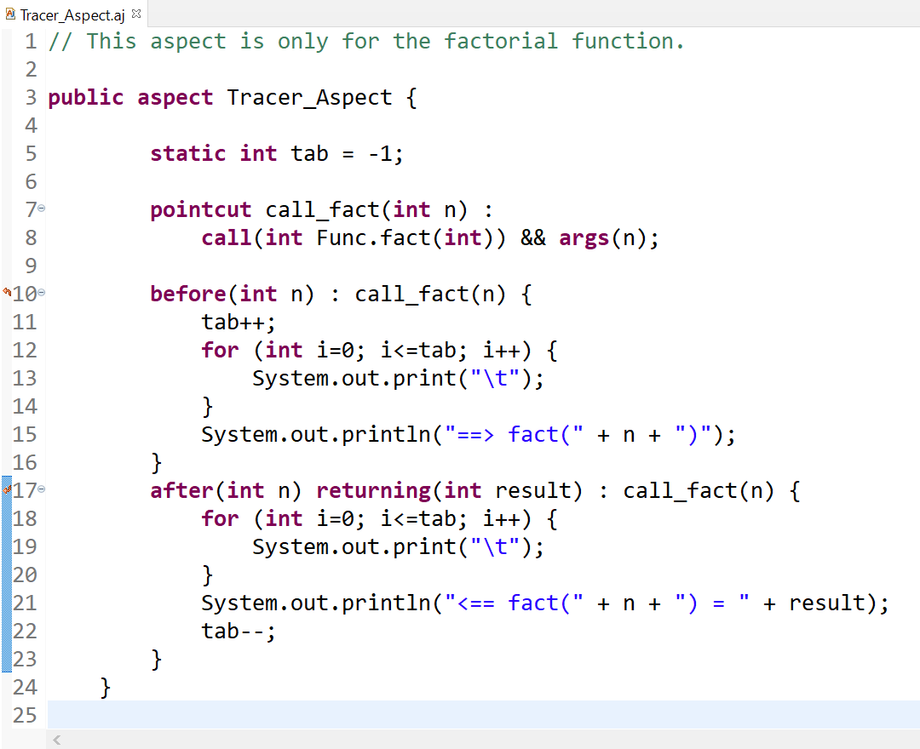
Tracer Aspect – Version 1
Method Call
Join Point

Slide 32
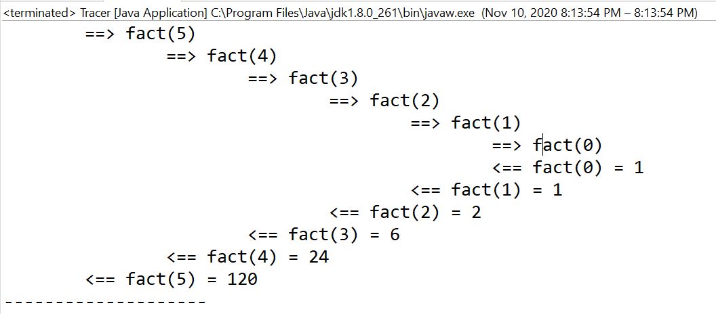
Console Output

Slide 33
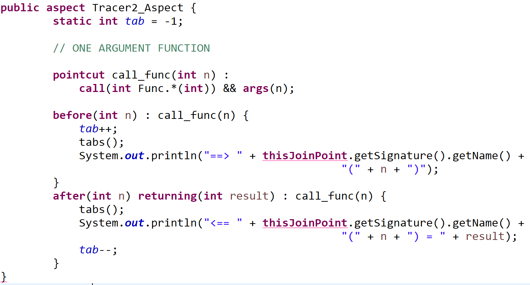
Tracer Aspect – Version 2
“Match any function in class
Func of type int → int”
“get the function’s name”

Slide 34
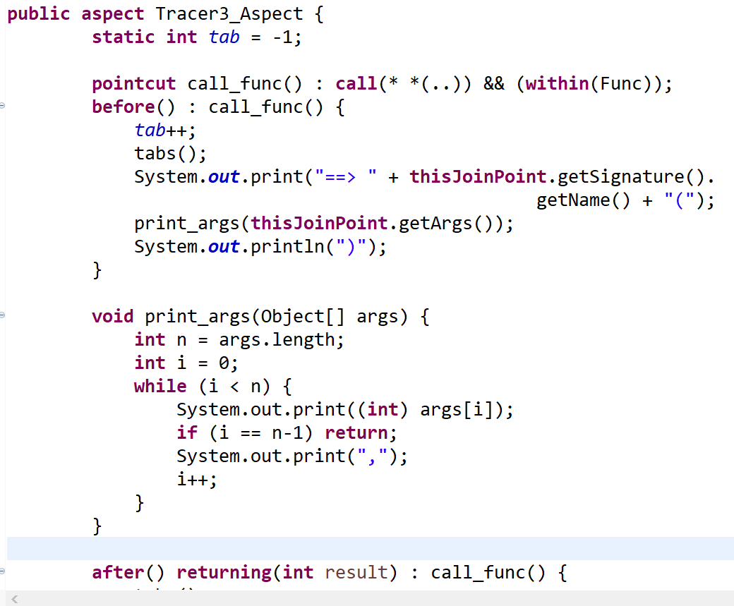
Tracer Aspect – Version 3
“Match any function in class Func"
“get all the
arguments”
All args assumed of type int
result also of type int

Slide 35
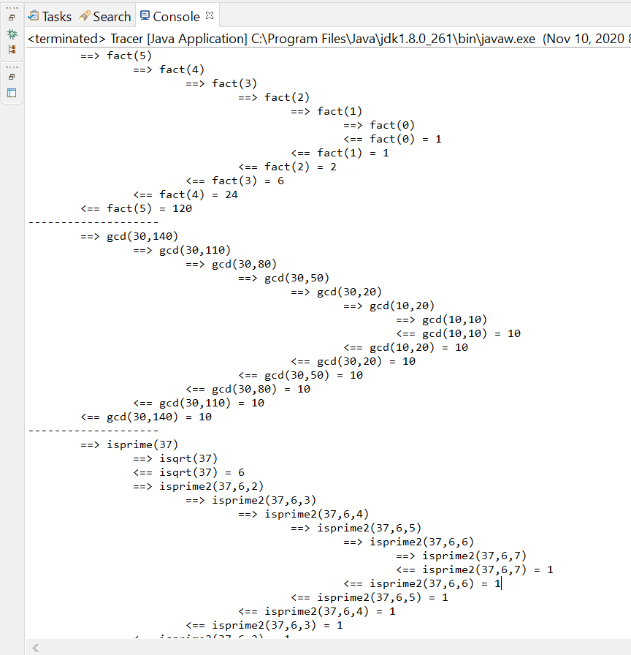
Console Output – Version 3

Slide 36
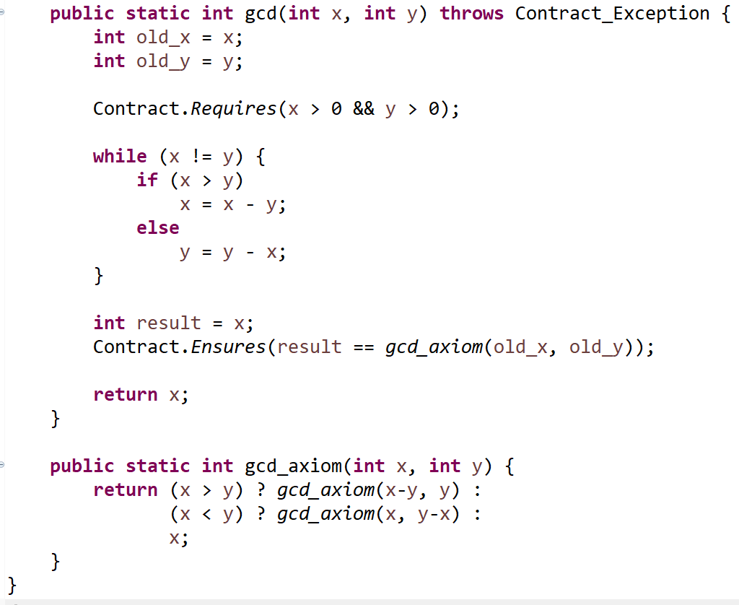
Example 3: Contracts
Can we separate
gcd code from contract code?
Lecture 19
slide #9

Slide 37
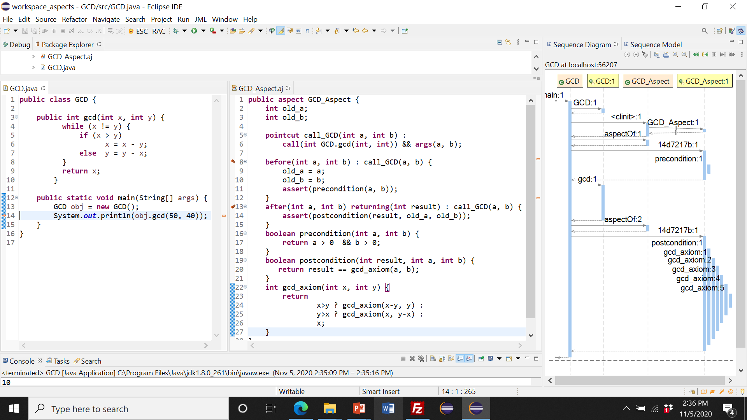
Contracts as Aspects
GCD aspect
GCD code
Contract code

